Slide 1
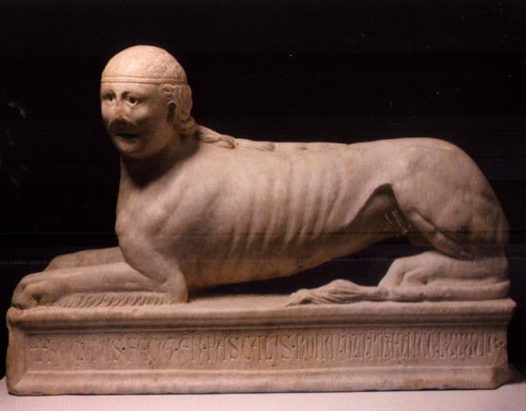
Sphinx
Paschalis Romanus
1286
Marble
H. 54 cm, W. 84 cm, D. 23 cm
Viterbo, Museo Civico, inv. 117

Slide 2
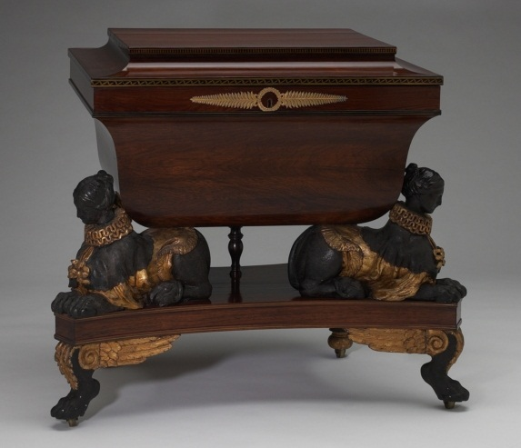
http://ecatalogue.art.yale.edu/imageServer/imgSrv?objectId=9730&size=large

Slide 3
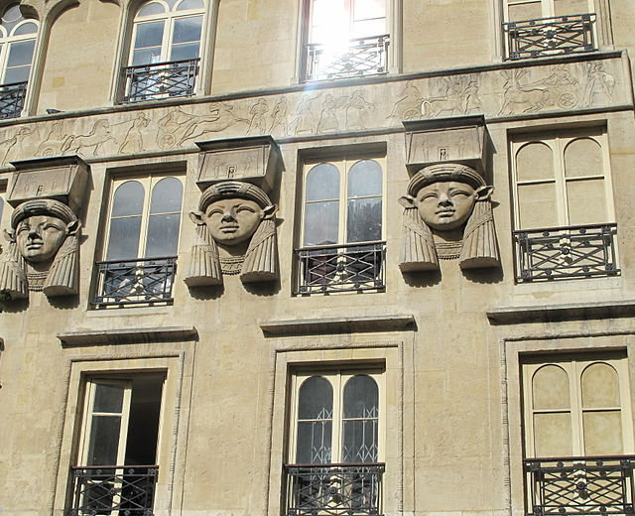
Building named "Fair of Cairo" built in 1798
Sculptor Petrel

Slide 4
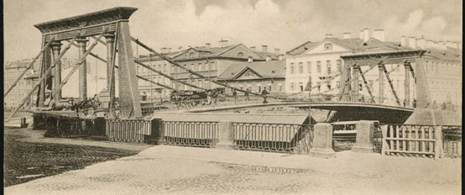
St. Petersburg Egyptian Bridge, 1825-1826
Designs by Von Traitteur and Christianowicz

Slide 5
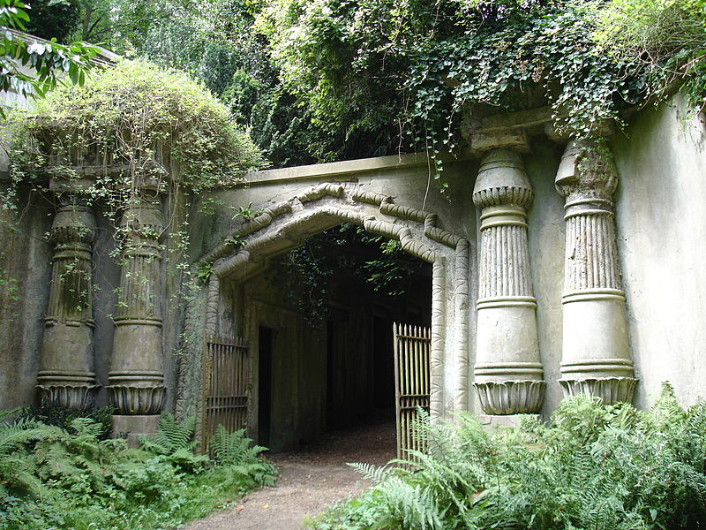
Egyptian Avenue at Highgate Cemetary, London, England

Slide 6
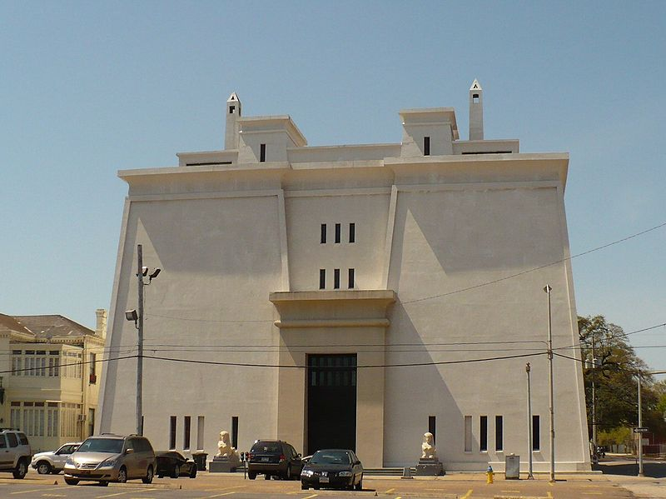
Scottish Rite Temple, Mobile Alabama
1921

