Slide 1
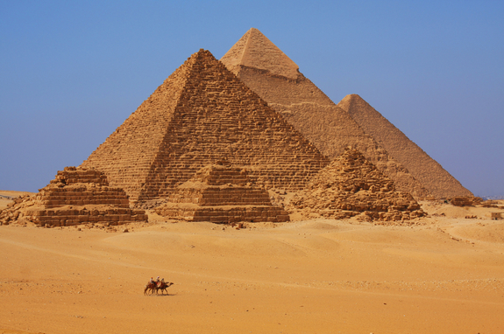
Valley of the Kings

Slide 2
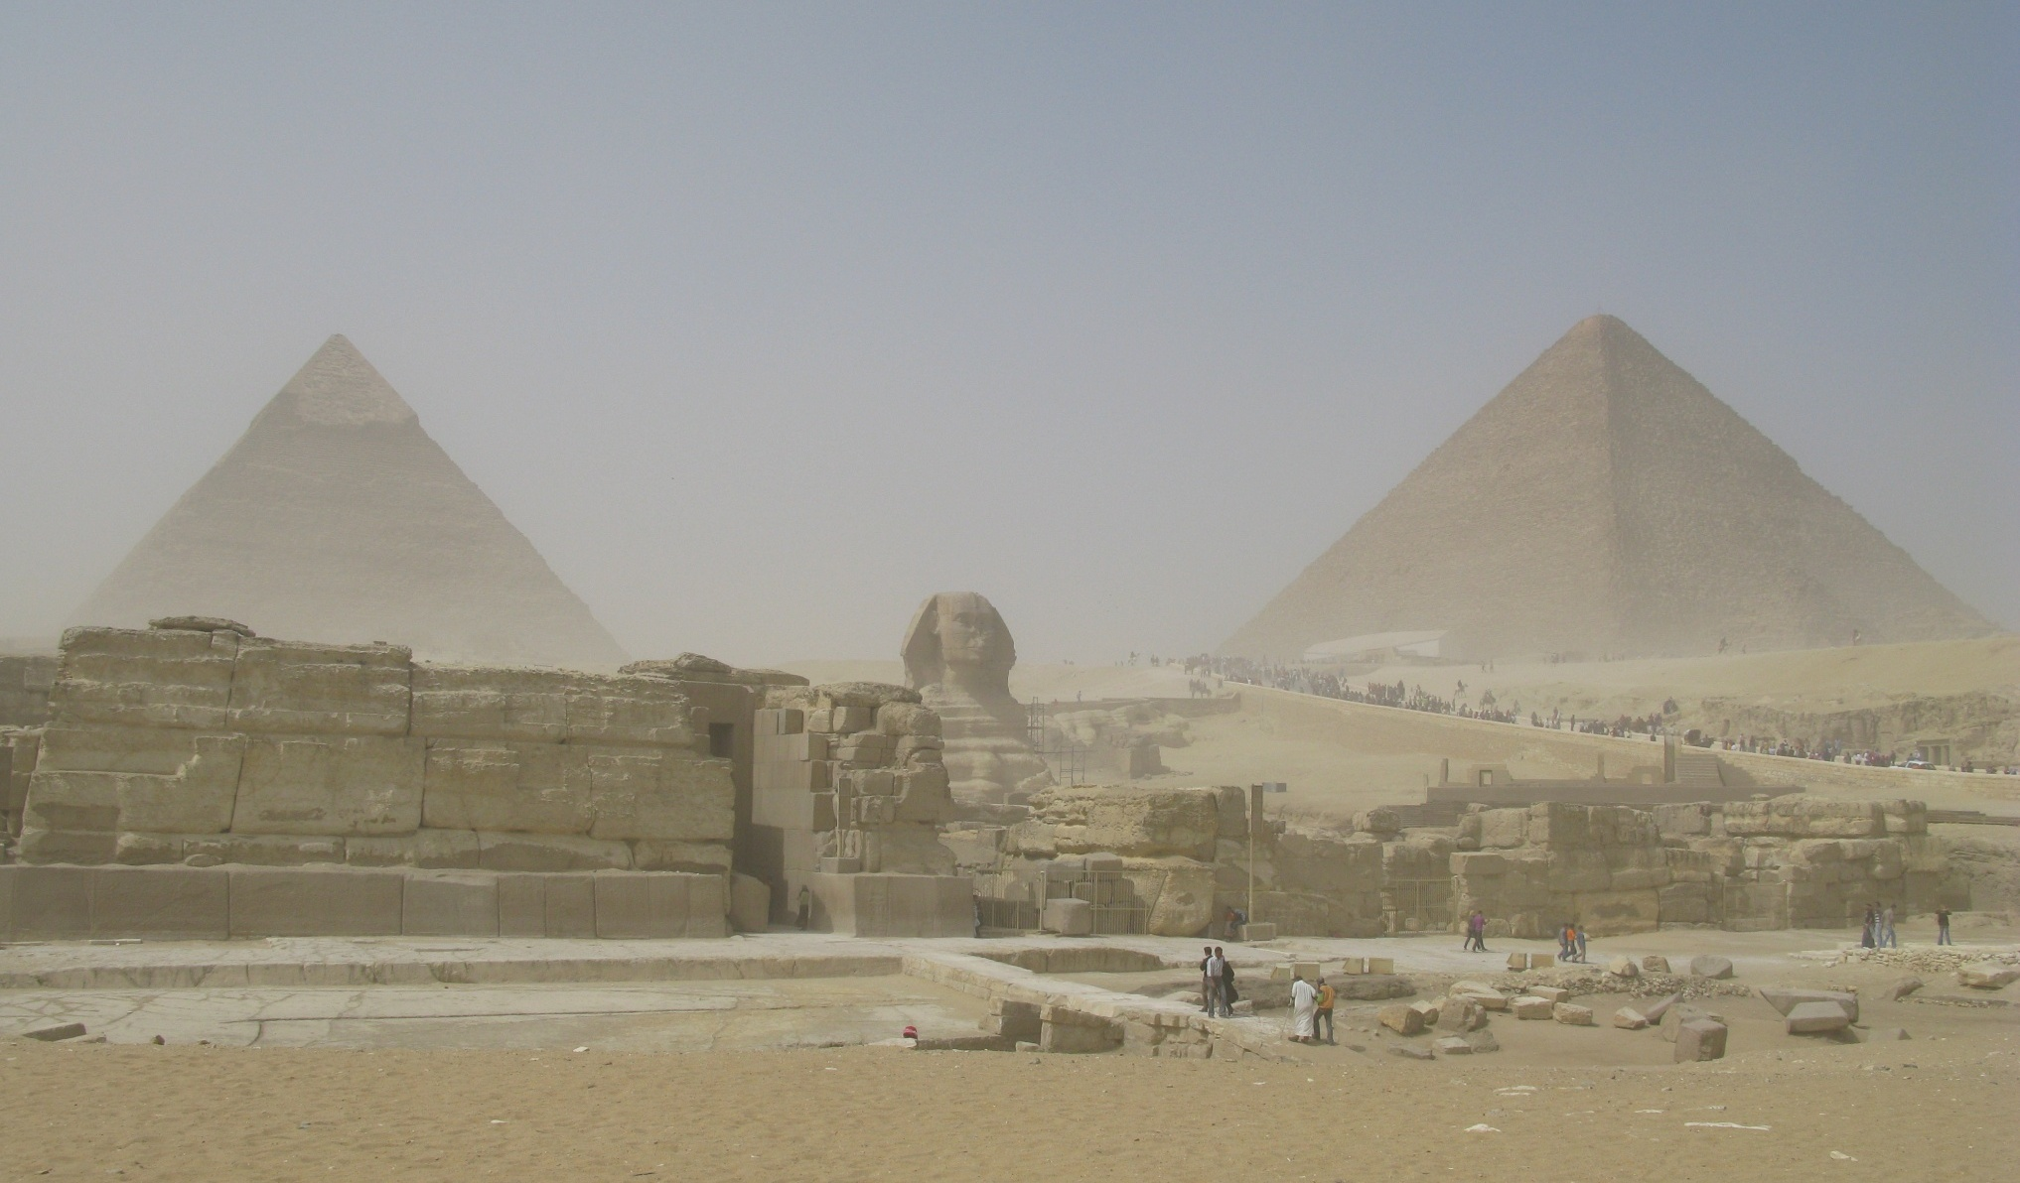
The Great Pyramids at Giza

Slide 3
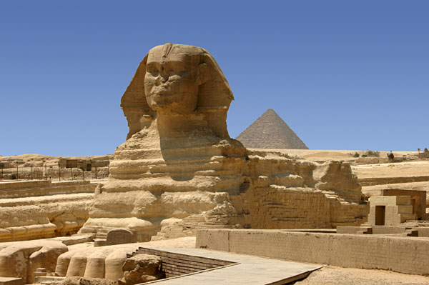
The Great Sphinx

Slide 4
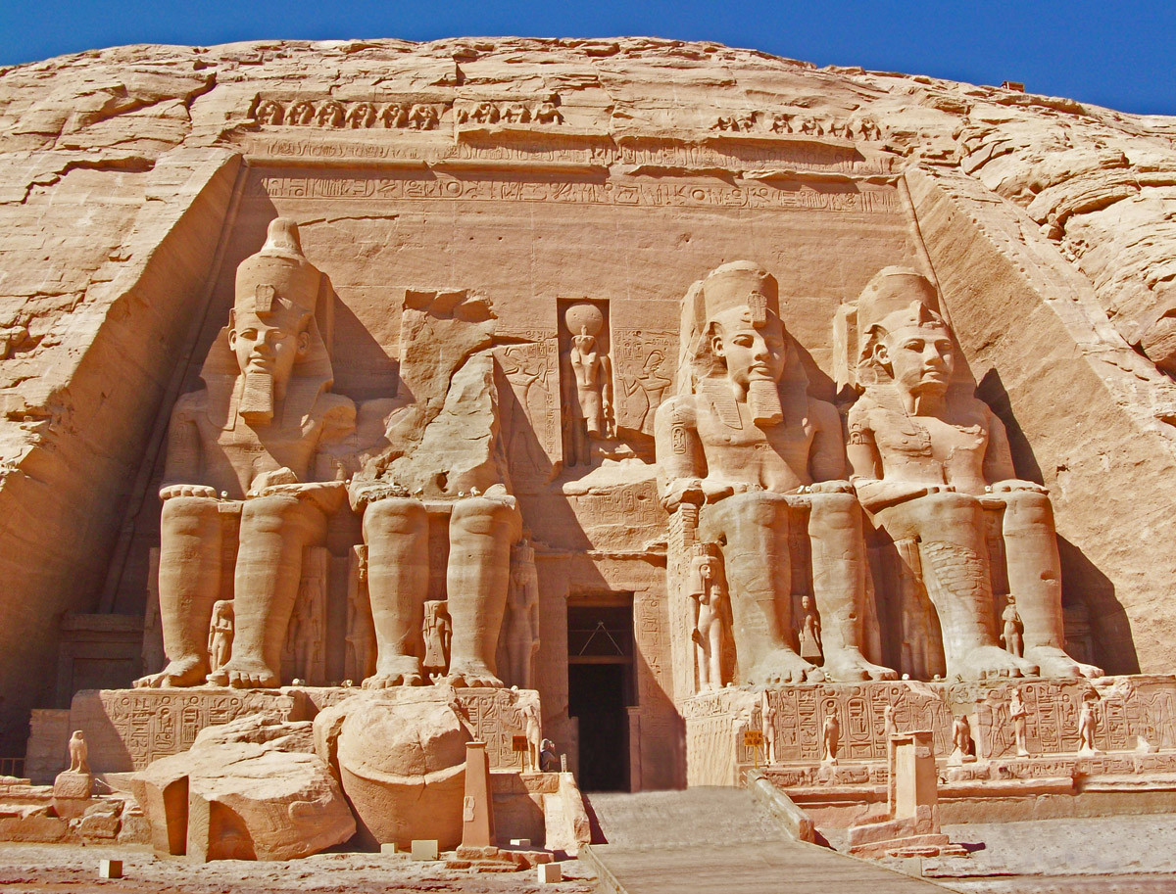
Abu Simbel

Slide 5
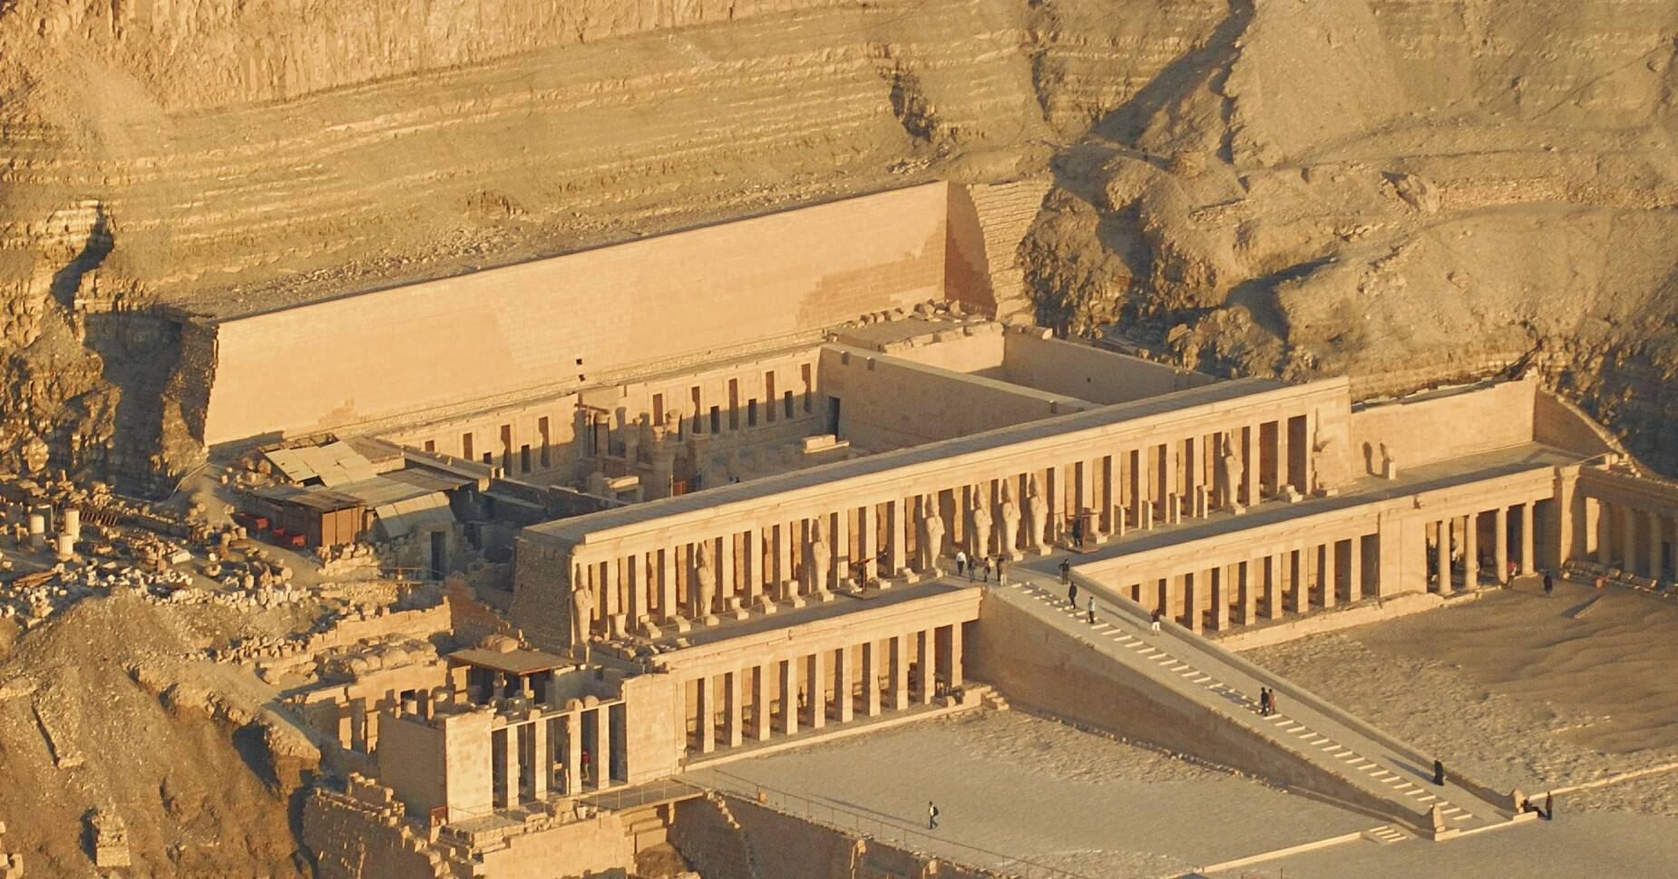
The Temple of Deir El Bahari (Hatshepsut’s Temple)

Slide 6
The Temple of Deir El Bahari (Hatshepsut’s Temple)

Slide 7
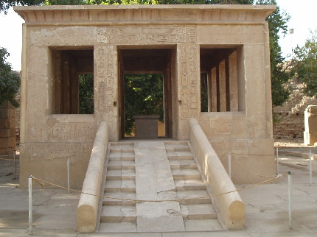
The White Chapel of Senusret I

Slide 8
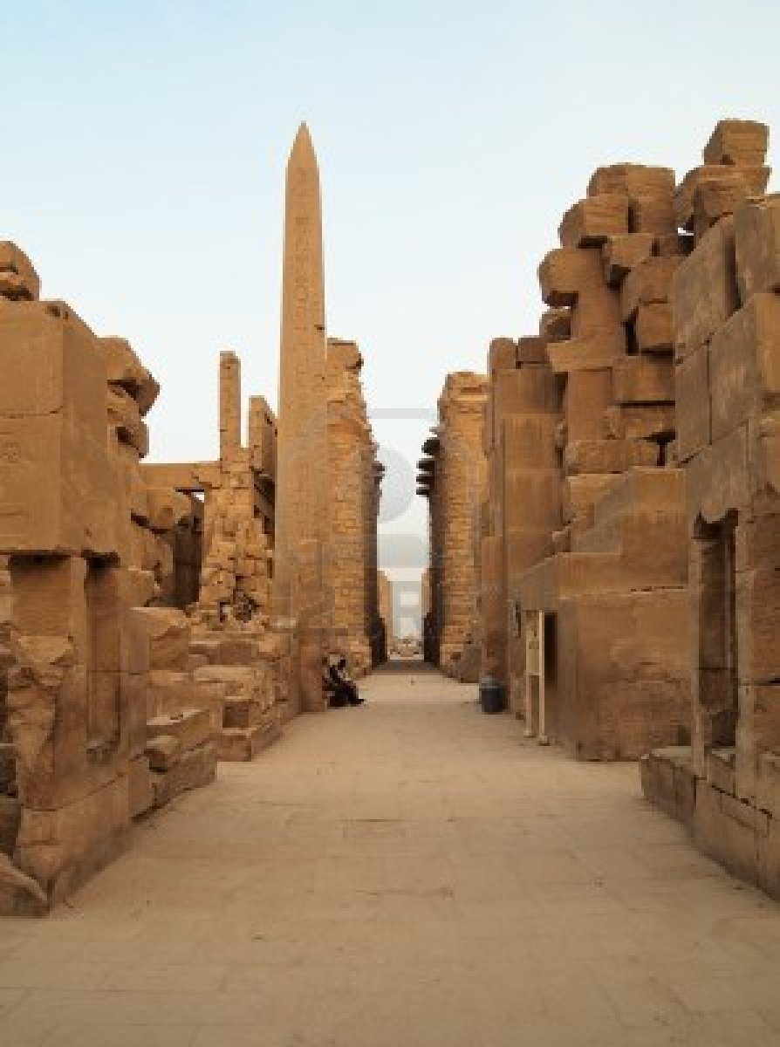
The Temple at Karnak

Slide 9
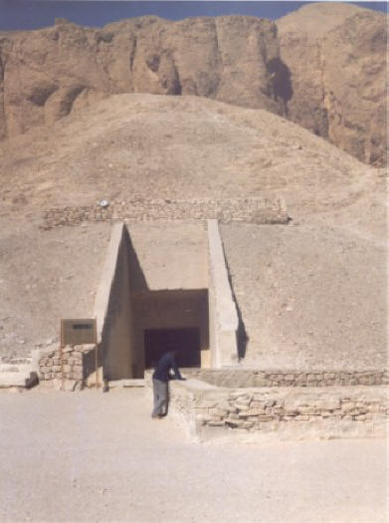
King Tut’s Tomb

Slide 10
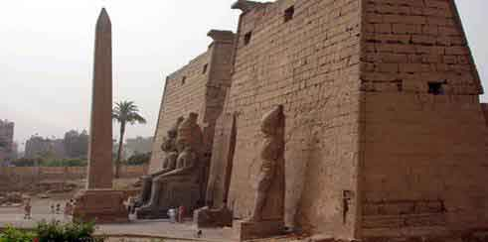
Luxor Temple

Slide 11
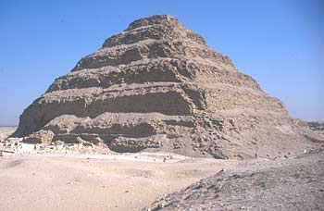
Step Pyramid of Djoser

Slide 12
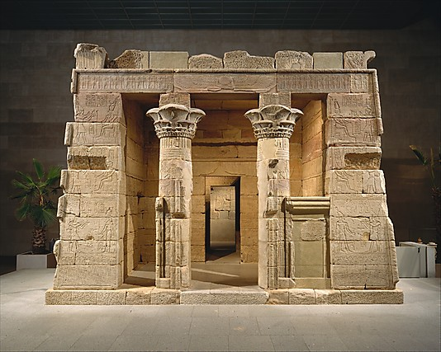
The Temple of Dendur

Slide 13
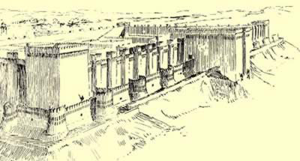
Mirgissa (Fort)

Slide 14
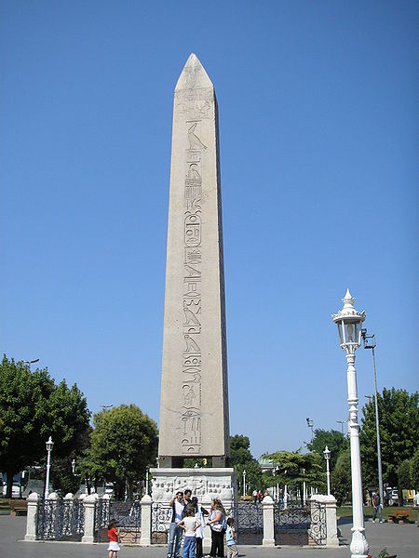
Obelisk of Theodosius

